Slide 1
The World Wide Web
Ganesh Kumar Ranjan
Faculty, MJMC,
MMHA&PU

Slide 2
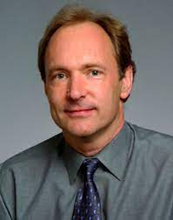
IDEA
How to put hypertext and computer network together
TIM BERNERS LEE
British Physicist
Working at CERN
He believed www should be available to everyone

Slide 3
The difference between the pre 1990’s version of the internet and one with the web lies in Berners Lee’s realisation of the internet’s potential for providing an accessible, connected web of information with pieces scattered on many different computers.
All network computers should be able to contribute to the web; and all information should be accessible to any users.

Slide 4
Lee wanted to achieve functionality like a ‘hypertext’ link within a web page to move through a different page with more detailed information.
The person creating the hypertext link did not need to have created the page that it clicked through to, nor it matter where in the world that page was held, so long as it was accessible.

Slide 5
Next thing Lee did was the writing of HTTP: Hyper Text Transfer Protocol.
HTTP allows the client machine to use transmission Control Protocol(TCP) to request access to a hypertext document held on a website located on a remote server.
HTTP
Through HTTP one machine access the material held on another.

Slide 6
HTTP would only work if it was [ossible to identify the location where the information wanted was held. A destination had to be given where requesting access to material.
URL (Uniform Resource Locater :to identify each destination uniquely)was developed
Every site to be included on the web would require its own URL, so that the client machine could use the HTTP language to access the information held there.

Slide 7
Each URL provide the details of exatly where the desire information is stored and typically starts with http://
HTML(Hyper Text Markup language)
To make the web page containing hypertext links
HTML allows a person reading a web page to click through another document or website.
http://info.cern.ch

